Slide 1
工作汇报
Notes:
欸卧槽了，一次训练得13天谁懂啊\😭/

Slide 2
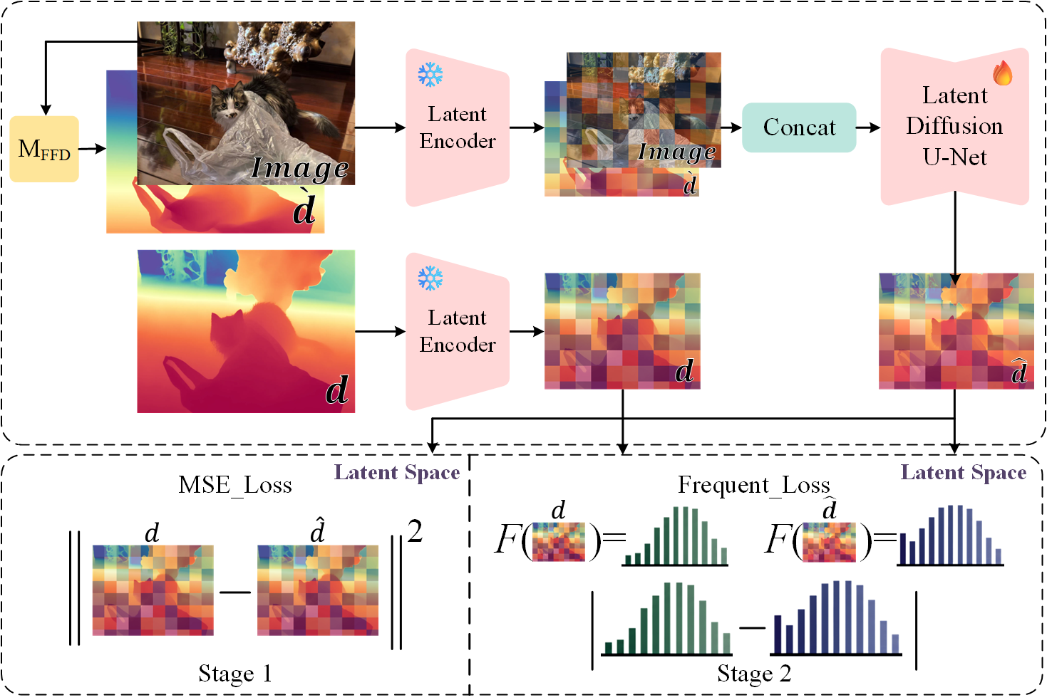

Slide 3
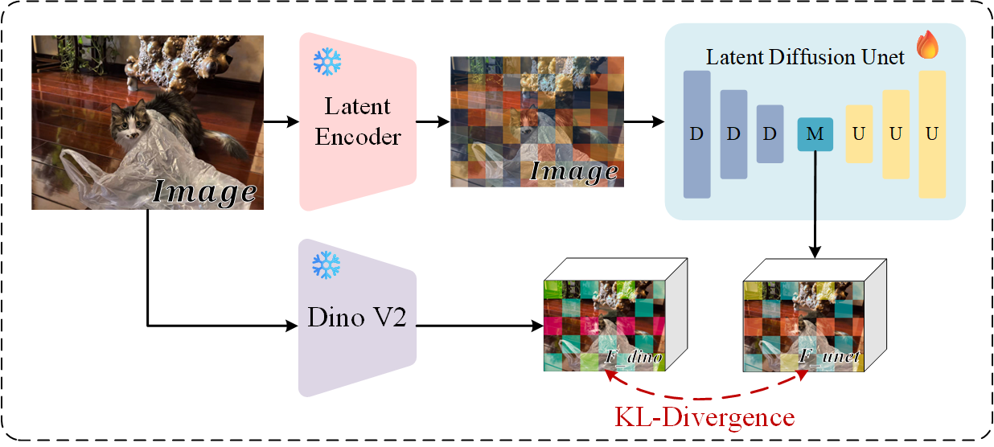

Slide 4
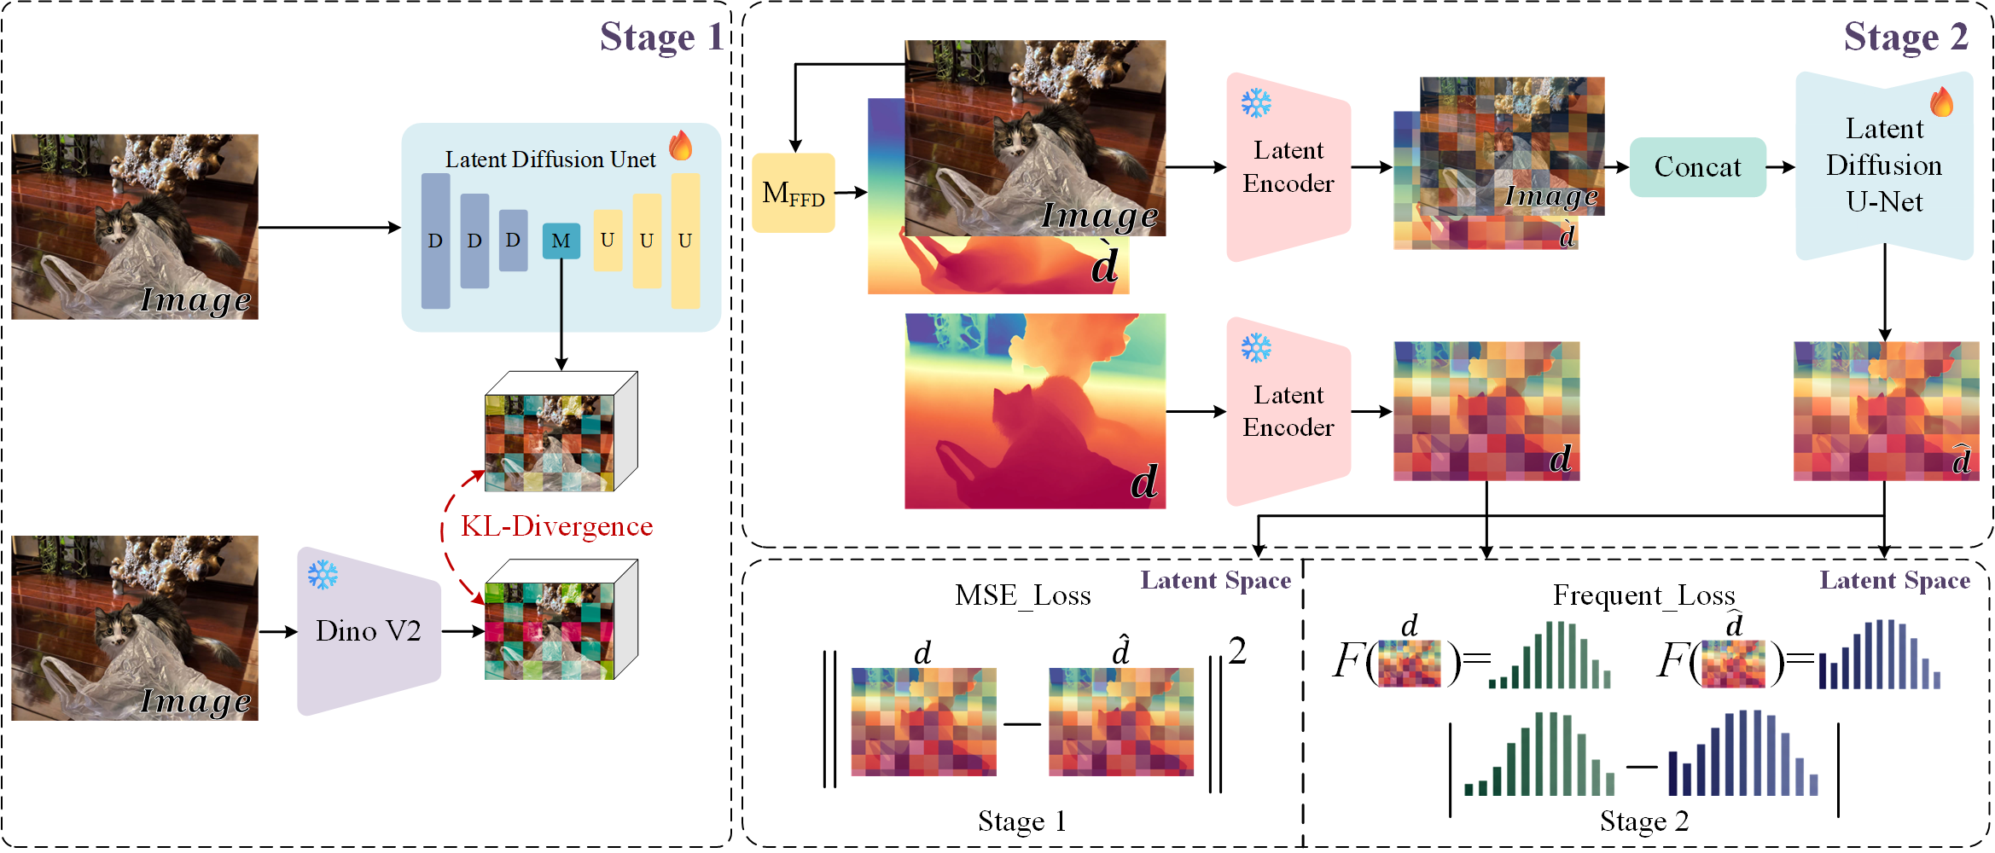

Slide 6
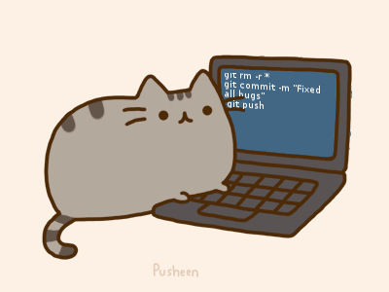
The end
Reference:
Ke B, Obukhov A, Huang S, et al. Repurposing diffusion-based image generators for monocular depth estimation[C]//Proceedings of the IEEE/CVF Conference on Computer Vision and Pattern Recognition. 2024: 9492-9502.Duan Y, Guo X, Zhu Z.
Rombach R, Blattmann A, Lorenz D, et al. High-resolution image synthesis with latent diffusion models[C]//Proceedings of the IEEE/CVF conference on computer vision and pattern recognition. 2022: 10684-10695.
Peebles W, Xie S. Scalable diffusion models with transformers[C]//Proceedings of the IEEE/CVF international conference on computer vision. 2023: 4195-4205.
Ho J, Jain A, Abbeel P. Denoising diffusion probabilistic models[J]. Advances in neural information processing systems, 2020, 33: 6840-6851.
Contact:
E-mail: Haruko386@outlook.com
Github: github.com/Haruko386
Training live show:
Wandb: https://wandb.ai/jw34617-shenyang-jianzhu-university/marigold/runs/vhifgqg7?nw=nwuserjw34617

